Slide 1
A legal glance at the regional adaptation of CEDAW and the role of civil society in advancing the process
Mtskheta, Georgia
May 2018
James F. Warren, Attorney at Law,
Warren Global Law

Slide 2
Introduction
Traditional attitudes to the status of women:
Men as rulers of their own households
Improvements in the 19th and early 20th century
Post World War II:
The formation of the United Nations:
Growing awareness of international dimensions of humanitarian issues
The Geneva conventions (1949)
Adoption of CEDAW (1979)

Slide 3
Convention on the Elimination of All Forms of Discrimination Against Women (1979)
http://www.un.org/womenwatch/daw/cedaw/cedaw.htm
Entered into force on September 3, 1981 with 99 signatures. As of today 189 countries have verified, acceded or succeeded to it.
Tajikistan and Georgia are signatories and bound by its terms.
The holdouts: United States (signed but not ratified), Iran, Somalia, Sudan, Tonga.

Slide 4
Response to CEDAW
Although nearly every country has adopted CEDAW, some are more committed to its ideals than others.
Some countries balked at certain provisions and many reservations were recorded. Mostly, but not exclusively, reservations came from Muslim countries.
European countries and Canada alleged that some countries with reservations were not truly committed.

Slide 5
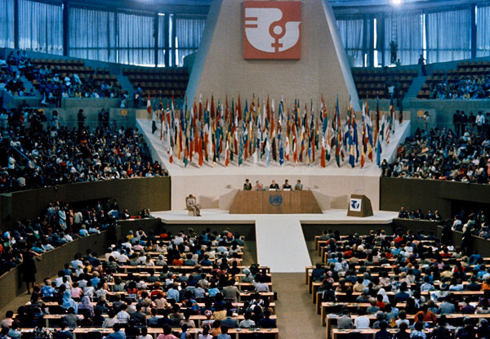
What does CEDAW say?
16 operative provisions plus procedural provisions. Commits nations to conform their laws to ensure that women have specified rights and privileges.
Prohibits all forms of legal discrimination in legal status and process. Essentially requires that women have the same legal standing as men.
Requires the elimination of all “prejudice and customary and all other practices which are based upon the inferiority or superiority of either of the sexes or stereotypical roles for men and women.”

Slide 6
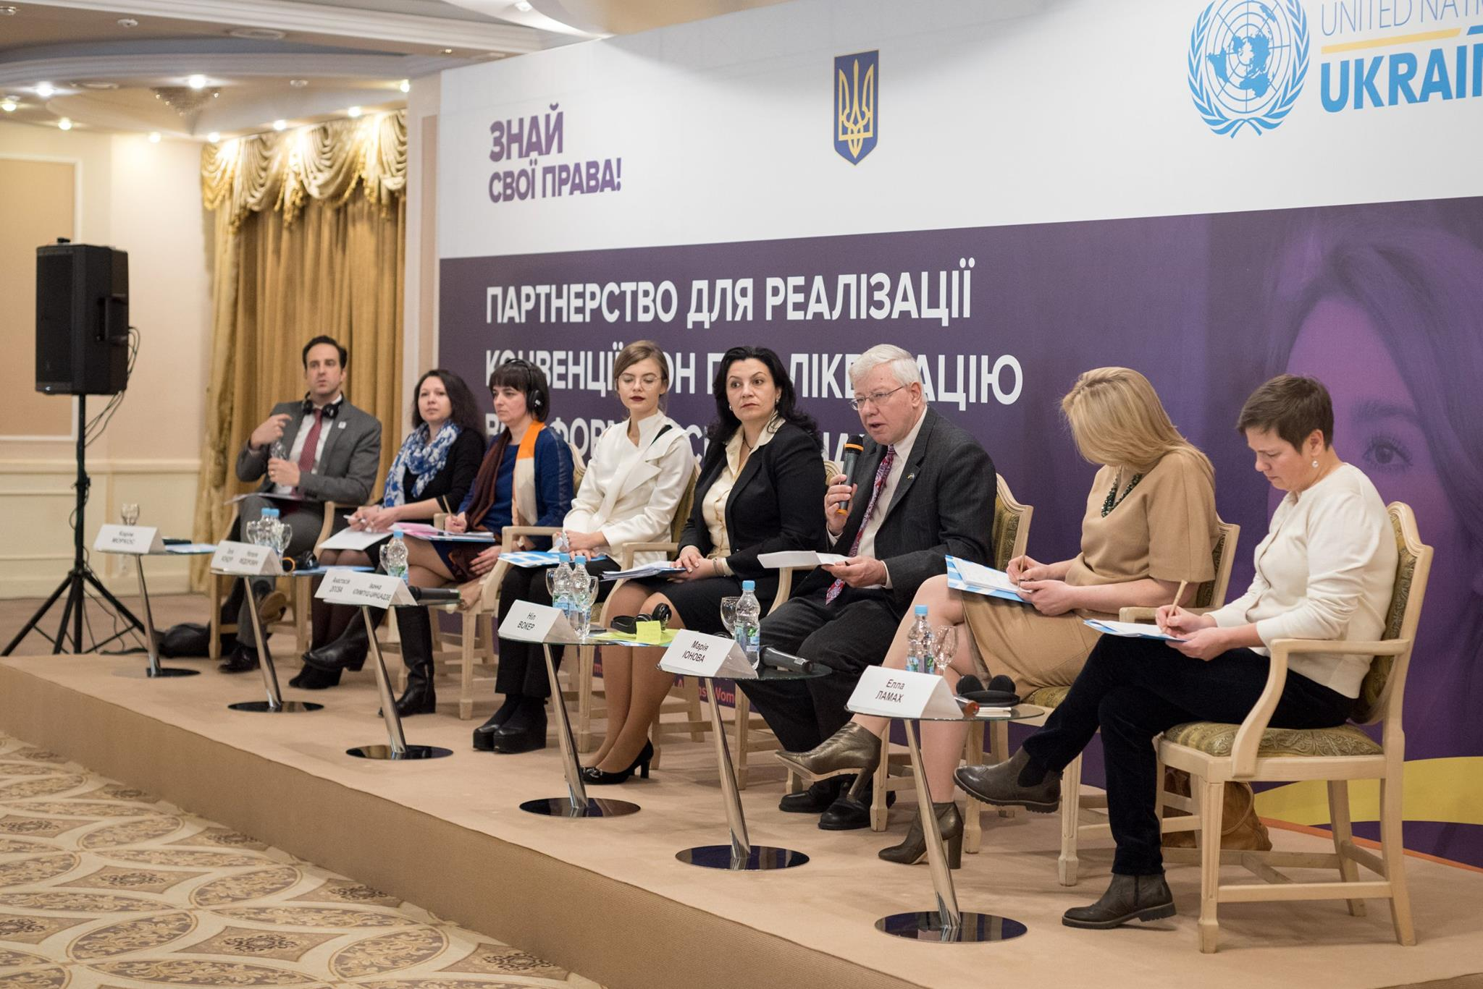
What does CEDAW say?
Calls for the suppression of “trafficking in persons” and prostitution, demands equal rights in nationality, career opportunities, education, healthcare, banking and financial dealings.
Addresses issues in rural areas, legal standing and right to contract, freedom of movement, marriage (including minimum age for marriage) and the official registration of all marriages.
Requires every participating nation to report on progress every four years.
Participating countries elected a CEDAW Committee of 23 experts to review country reports and to make recommendations.

Slide 7
CEDAW as originally drafted did not say anything about domestic violence
In 1992, the CEDAW Committee’s General Recommendation No. 19 said that CEDAW also applied to « gender-based violence, that is violence that inflicts physical, mental or sexual harm or suffering, threats of such acts, coercion and the deprivation of liberty. »
Declaration of the Elimination of Violence against Women, UN General Assembly Resolution 48/104 (December 20, 1993) urges states to sign on to CEDAW or withdraw their reservations.
Optional Protocol (1999) – with 80 signatures and 109 adopters - added complaint and enforcement procedures and permitted individual complaints, but granted no new substantive rights. Tajikistan recorded a reservation on the Optional Protocol.

Slide 8
Other international responses to domestic violence
Maputo Protocol (2003) to the African Charter on Human and Peoples’ Rights (entered into force November 25, 2005) prohibits violence against women. It was a very contentious document, opposed by the Catholic Church and some traditional societies.
In 2011, the Council of Europe through its Council of Ministers adopted the Convention on Preventing and Combating Violence against Women and Domestic Violence (the “Istanbul Convention”) (entered into force August 1, 2014). It specifically requires states to enact laws to prevent domestic violence, protect the victims and prosecute the offenders. A very detailed list of requirements includes data collection, support for civil society, education, training of professionals, provision of shelters and 24-hour telephone helplines, etc.
ECHR said in Opuz v. Turkey (December 12, 2015) that gender-based violence is a form of discrimination under Article XIV of the European Convention.

Slide 9
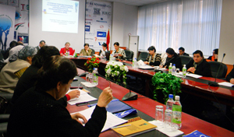
Tajikistan
Country reports produced in 2002 and 2010. The 2017 report has not yet appeared. Both reports tried to assert that women are equally treated but the reports were not well received by the CEDAW Committee.
“Certain laws in the Republic of Tajikistan govern questions of family violence. Individual provisions in the Criminal Code apply to men who use violence against their wives. Criminal charges have been brought against very few men who use violence against their wives.”

Slide 10
Tajikistan
A 2013 shadow report by a group of NGOs catalogues the reality – a number of National Plans have been produced and a new Domestic Violence Law was adopted in 2013 (providing legal, medical and mental health services) but the response has been half-hearted and traditional attitudes remain strong, particularly in rural areas.
Lack of funding, limited awareness of the issue, absence of effective enforcement.
Gaps remain in the law – e.g. unregistered religious marriages have no protection under the Family Code.

Slide 11
Georgia
Country reports produced in 1998, 2004 and 2012
“Traditionally, gender-based discrimination and negligence of women’s rights have not been recognized in Georgia, and no effective study in this direction.”
Presidential Decree #64 (February 25, 2000) – “On Approval of the Plan of Action in Combating Violence against Women for 2000 – 2005.”
Minister of Internal Affairs, in conjunction with President’s office, was instructed to:
Collect the data on violence against women;
Conduct a register of domestic violence incidents; and
Take preventative measures to explore and eliminate such kinds of violence.
Trainings conducted at police stations across the country, criminal penalties increased.
Measures to prevent prostitution and sexually oriented trafficking in persons.

Slide 12
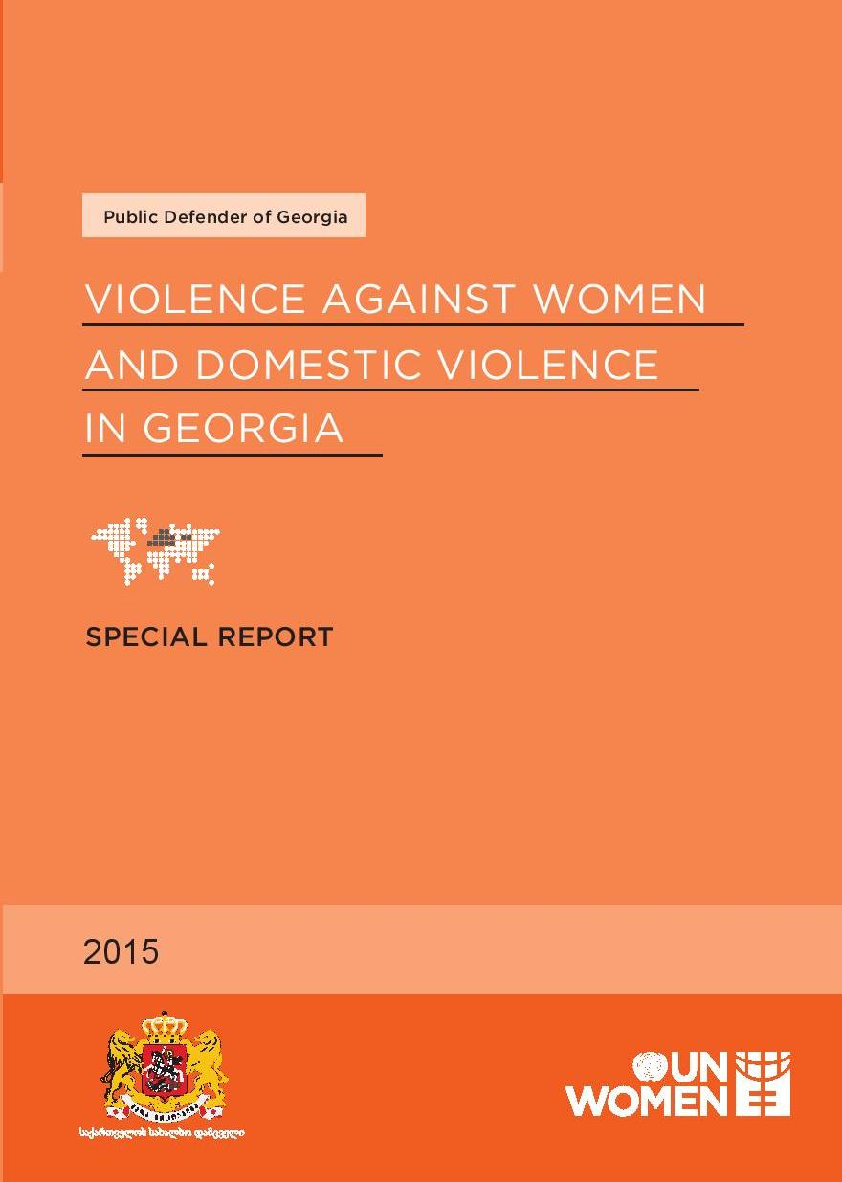
Georgia
Starting in 2007, in response to the CEDAW Committee’s 2006 critical review of the 2004 country report, the Georgian government took a wide variety of steps to improve women’s situation – enhanced training, poverty prevention, healthcare improvements, etc.
Problems remain – no law on spousal rape, human trafficking (despite criminalization in 2003-2006), workplace violence.
2012 country report acknowledged that Georgia did not have a law on domestic violence.
2014 Georgia signed the Istanbul Convention; adopted National Action Plan on Gender Equality.
NGOs are focusing on raising awareness among women, improving access to safety and support, and fighting for more resources.

Slide 13
Takeaways – “From De Jure Equality towards De Facto Equality”
Almost every country in the world has a government aware of the problem.
The laws and programs are often in place, but traditional attitudes and lack of resources limit their effectiveness.
Working with the responsible institutions is vital and may help counter lack of resources. It takes civil society working with multiple state agencies to make progress.
The police and police training are critical components. They have to understand and be willing to enforce the law.
In the fight against domestic violence you have allies all over the world – this is a “transformative” but not a “revolutionary” effort.

Slide 14

Thank you! This presentation was funded by Last Mile4D

