Slide 1
HOW TO ORGANIZE AND ADVOCATE ON BEHALF OF DOMESTIC VIOLENCE VICTIMS
May 10, 2018
Domestic Violence – A Regional Exchange among Social Workers and Health Providers from Georgia, Iran and Tajikistan
Tbilisi, Georgia
REBECCA REINGOLD
Institute Associate, O’Neill Institute for National and Global Health Law
Adjunct Professor of Law, Georgetown University Law Center
rr951@law.reorgetown.edu

Slide 2
2
ADVOCACY SKILLS BUILDING SESSION
STRUCTURE OF THE PRESENTATION
Introduction to Advocacy
Actor Mapping
Advocacy Participatory Workshop

Slide 3
3
ADVOCACY SKILLS BUILDING SESSION
SECTION 1
INTRODUCTION TO ADVOCACY
O’Neill Institute for National and Global Health Law
Research Projects
Scholarship
Capacity Building/Teaching
LL.M. Program
Certificate Programs
Summer Programs

Slide 4
4
ADVOCACY SKILLS BUILDING SESSION
SECTION 1: INTRODUCTION TO ADVOCACY
WHAT IS ADVOCACY?
“Advocacy is the deliberate process, based on demonstrated evidence, to directly and indirectly influence decision makers, stakeholders and relevant audiences to support and implement actions that contribute to the fulfillment of children’s and women’s rights.” (UNICEF)
“Advocacy is an organized attempt to change policy, practice, and/or attitudes by presenting evidence and arguments for how and why change should happen.” (OSF)
“Advocacy is a set of political actions implemented according to a strategic plan and aiming to focus the attention of the community on a specific problem and guide decision makers toward a solution.” (IPPF/WHR)

Slide 5
5
ADVOCACY SKILLS BUILDING SESSION
SECTION 1: INTRODUCTION TO ADVOCACY
WHAT IS NOT ADVOCACY?
Information, Education, Communication (IEC)
Community Mobilization
Public Relations
Fundraising

Slide 6
6
ADVOCACY SKILLS BUILDING SESSION
SECTION 1: INTRODUCTION TO ADVOCACY
OVERVIEW OF THE PROCESS
STEP 1
Identify and analyze the issue
STEP 2
Set the goal and objectives
STEP 3
Identify the decision makers
STEP 4
Define the message and the “ask”
STEP 5
Set your timeline
STEP 7
Monitor, evaluate, and share
STEP 6
Assess resources, choose tactics, and implement

Slide 7
7
ADVOCACY SKILLS BUILDING SESSION
SECTION 2
ACTOR MAPPING
O’Neill Institute for National and Global Health Law
Research Projects
Scholarship
Capacity Building/Teaching
LL.M. Program
Certificate Programs
Summer Programs

Slide 8
8
ADVOCACY SKILLS BUILDING SESSION
SECTION 2: ACTOR MAPPING
AUDIENCE CLASSIFICATION
Primary
Those who are directly involved in the decision making process
Secondary
Those who are in a position to influence those who are directly involved in the decision making process

Slide 9
9
ADVOCACY SKILLS BUILDING SESSION
SECTION 2: ACTOR MAPPING
AUDIENCE ANALYSIS
Power
The authority of a certain actor to make decisions required by the advocacy goal/extent of their involvement regarding the achievement of the advocacy goal
Position
The actor’s specific position concerning the achievement of the advocacy goal
Interest
The actor’s willingness to commit to the achievement or prevention of the advocacy goal

Slide 10
10
ADVOCACY SKILLS BUILDING SESSION
SECTION 2: ACTOR MAPPING
AUDIENCE ANALYSIS
Name | Institution | Position | Power (0-5) | Position (-5-5) | Interest (0-5)

Slide 11
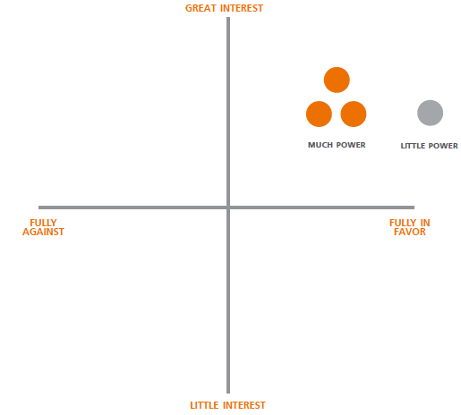
11
ADVOCACY SKILLS BUILDING SESSION
SECTION 2: ACTOR MAPPING

Slide 12
12
ADVOCACY SKILLS BUILDING SESSION
SECTION 2: ACTOR MAPPING

Slide 13
13
ADVOCACY SKILLS BUILDING SESSION
SECTION 3
ADVOCACY PARTICIPATORY WORKSHOP
O’Neill Institute for National and Global Health Law
Research Projects
Scholarship
Capacity Building/Teaching
LL.M. Program
Certificate Programs
Summer Programs

Slide 14
14
ADVOCACY SKILLS BUILDING SESSION
SECTION 3: ADVOCACY PARTICIPATORY WORKSHOP
OUTLINE OF WORKSHOP
STEP 1:
Identify advocacy goal
STEP 2:
Brainstorm people who form the audience you are analyzing
STEP 3:
Determine whether they are primary or secondary audiences
STEP 4:
Insert them into audience analysis chart and complete chart
STEP 5:
Transfer the results of the audience analysis to the audience map
STEP 6:
Define strategies for engaging with the people included in audience map

Slide 15
15
ADVOCACY SKILLS BUILDING SESSION
SOURCES
International Planned Parenthood Federation Western Hemisphere Region, Handbook for Advocacy Planning (2010)
OSI, An Introductory Guide to Successful Advocacy (2010)

Slide 16

Thank you! This presentation was funded by Last Mile4D

