Slide 1
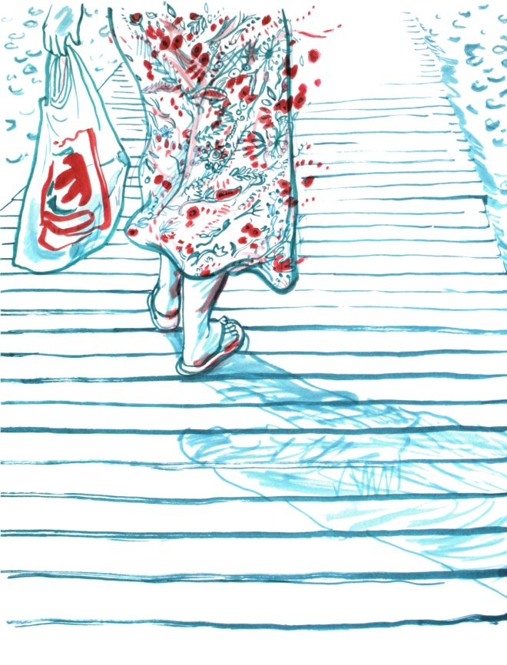
Spanish Model-Domestic Violence
PhD. Barbara Tardón Recio
May 2018
Tibilisi, Georgia
©Clara León

Slide 2
Outline
Spanish Model-Domestic Violence: Measures to Offer Comprehensive Protection Against Violence Against Women, Organic Act 1/2004.
Special Measures:
Violence Againts Women´s Courts
Victim´s Rights:
Assisance, emergency, support and shelter and full recovery: Autonomous Community of MadridMadrid Municipality.
Public Policy and Budget

Slide 3
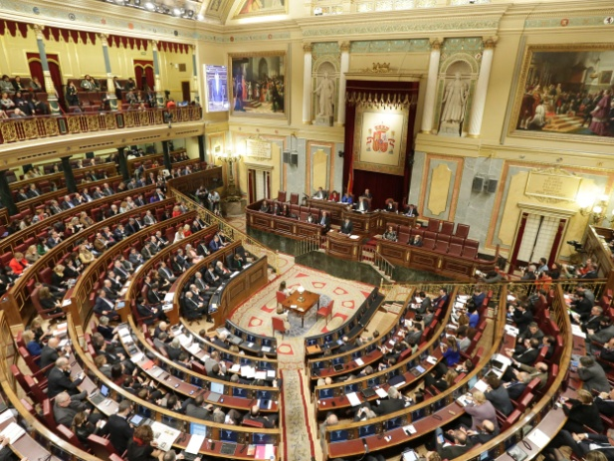
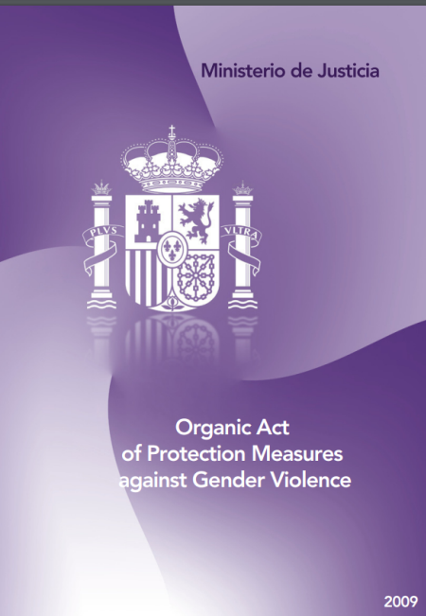
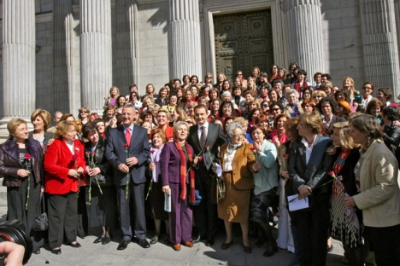
Spanish Model-Domestic Violence
January 2005: Measures to Offer Comprehensive Protection Against Violence Against Women, Organic Act 1/2004
Spanish Parliament
“…to act against violence that, as a manifestation of discrimination, a situation of inequality and the power relationships men hold over women, is carried out against those who have been their husbands, or those who are or have been connected to them through similar bonds of intimacy, living together or apart” (Section 1.1)
It was approved unimously by the Spanish Parliament.
Spanish President and women´s movement:. 2005

Slide 4
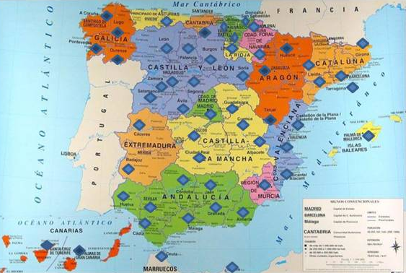
Spanish Model-Domestic Violence: Violence Againts Women´s Courts
The creation of specific tribunals : Violence Againts Womens Courts
“Thes new Courts will examine and, where appropriate, rule on criminal cases involving violence against women, as well as any related civil causes, such that both are dealt with in first instance before the same bench” (Preamble)”
106 specific courts
75 other courts

Slide 5
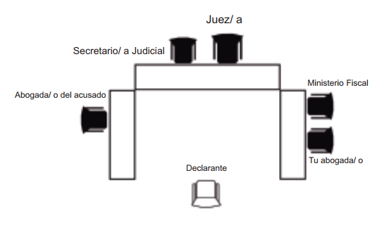
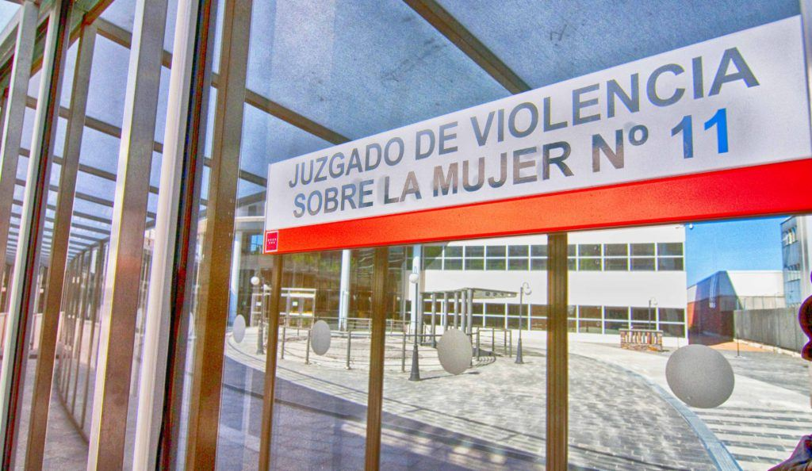
Spanish Model-Domestic Violence: Violence Againts Women´s Courts
Judicial clerk
Court room
Judge
Public prosecutor
Woman lawyer
Prosecuting lawyer
Declarant

Slide 6
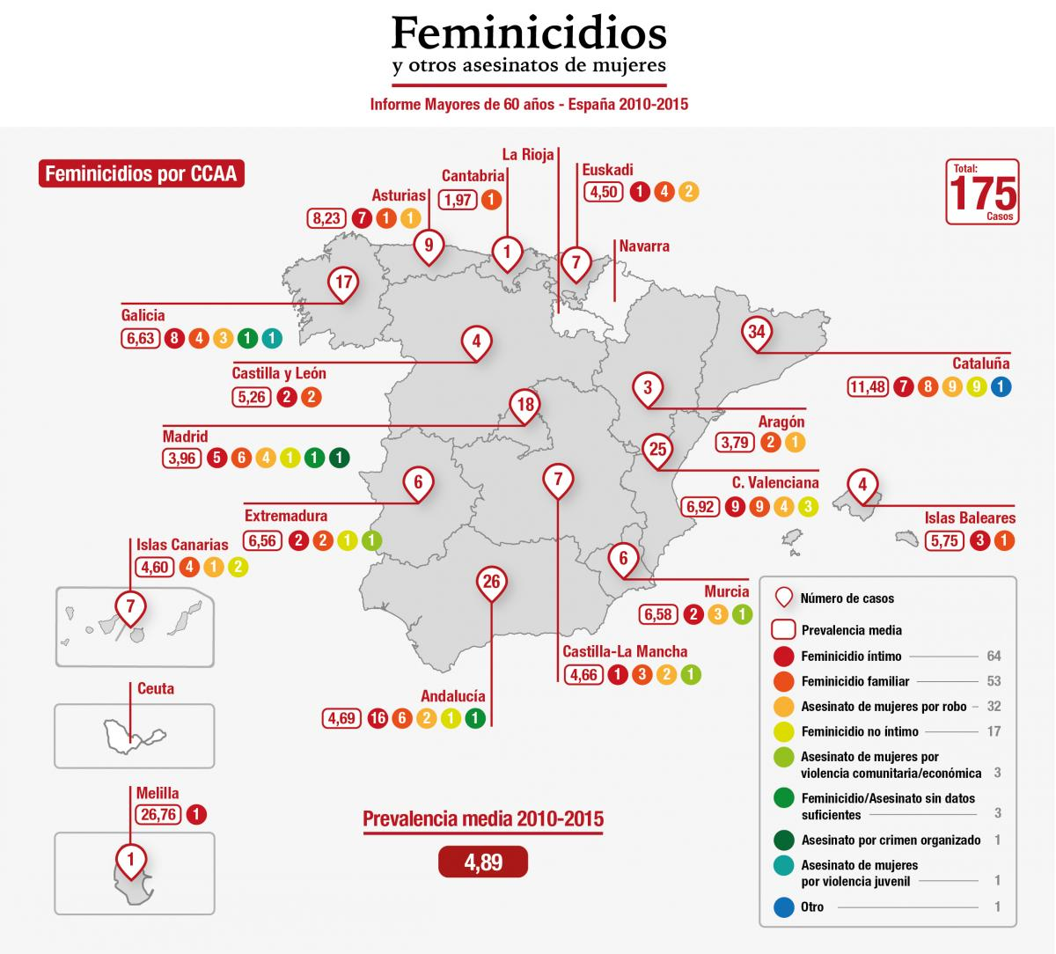
Spanish Model-Domestic Violence: Violence Againts Women´s Courts
© Feminicidio.net
In Spain, the average number of women killed each year hits 70 at its worst, but is just of the tip of the iceberg when it comes to the atrocity of violence towards women and their children.
The specialized courts are still far from giving a victim of constatan infringement of her rights the answer she deserve and is due, for justice, ethics and social responsability´s sake.

Slide 7

Spanish Model-Domestic Violence: Victim´s Rights
2. Guarrantee of Victims Rights: “to helping them to put and end to the violent relationship and resume their life plan”
“These rights are universal, in the sense that they are guaranteed to all women who have suffered acts of domestic violence, regardless of their origin, religion or any other personal or social status or ciscunstance”
Right to information
Right to comprehensive social assistance: assistance, emergency, support and shelter and full recovery.
Right to immediate and specialised legal aid.
Righ of residence and work authorisation, irrespetive of migrant women reunited with their husband or partner. Length of the authorisation 5 years.
Right to temporary residence and work authorisation on grounds of expectional circumstances.
Right to protection.
And Right to asylum.

Slide 8

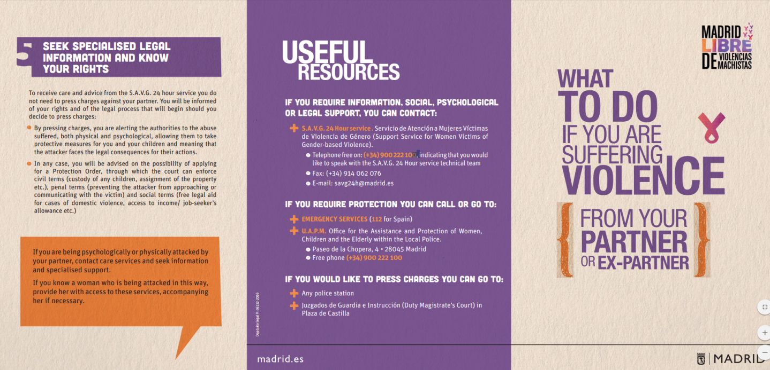
Spanish Model-Domestic Violence: Assistance, emergency, support and shelter
Autonomous Community of Madrid
Madrid Municipality:
assisance, emergency, support and shelter and full recovery

Slide 9
Spanish Model-Domestic Violence: Assistance, emergency, support and shelter
Autonomous Community of Madrid
Madrid Municipality:
assistance, emergency, support and shelter and full recovery
012 Mujer: phone line
S.A.VG 24: hours service (Support Service for Women Victims of Domestic Violence): emergency service
Municipal Points of the Regional Observatory on Gender Violence: They offer information, orientation, psycological care and labor law services for victims of domestic violence at a local (municipality) level.
The shelters for victims of domestic violence: consist of specific, residential and non-residential resources, intented to provide comprehensive care for women, children and dependants who have been victims of domestic violence. The main services provide are accommodation, food, support, psycological care, legal counseling, labor law services and security.

Slide 10
Spanish Model-Domestic Violence: Assistance, emergency, support and shelter
Autonomous Community of Madrid
Madrid Municipality:
assisance, emergency, support and shelter and full recovery
The shelters are composed by residential and non-residential resources:
1) Emergency shelters: 3 months stay
2) Accomomodation shelters: 1 year stay
3) Protected flat: 1 year stay
Psychosocial Care Center for victims of Domestic Violence and their children: It´s a specialized pyschosocial care resource that aims at the emotional ans social recovery of women and their children.

Slide 11
Spanish Model-Domestic Violence: Public Policy and Budget
The development of this law and It´s implementation requieres the commitment of the state, the autonomous communities and the municipal authorities, with adequate public policies and budgetary allocations.
Law
Public Policies
Resources
National Strategy for the eradication of violence againts women (2013-2016): is a backbone of the actions taken by the public authorities to put an end to the violence suffered by women simply because the are women.

Slide 12
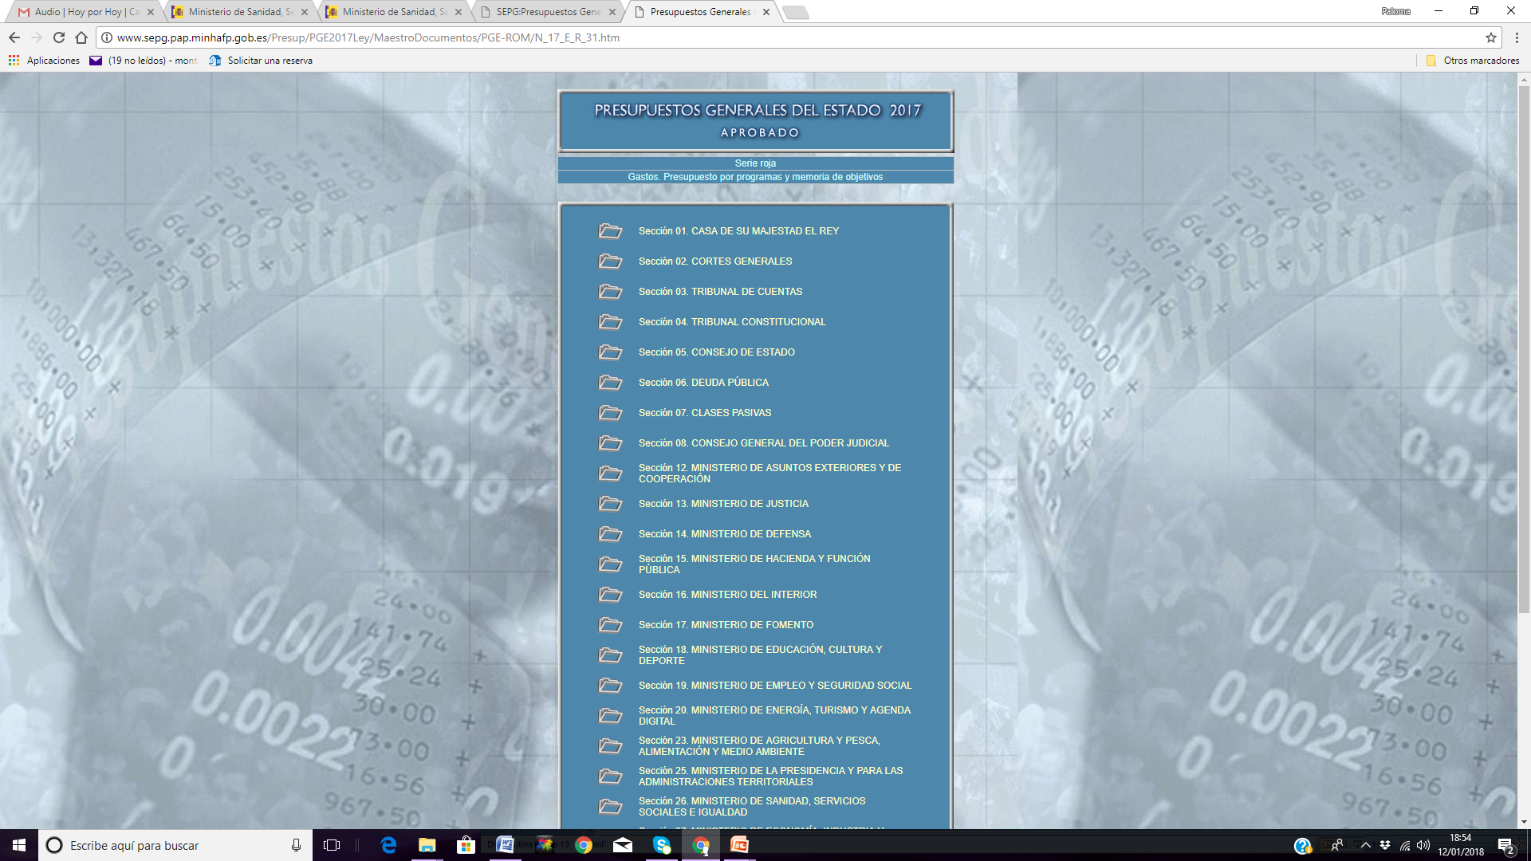
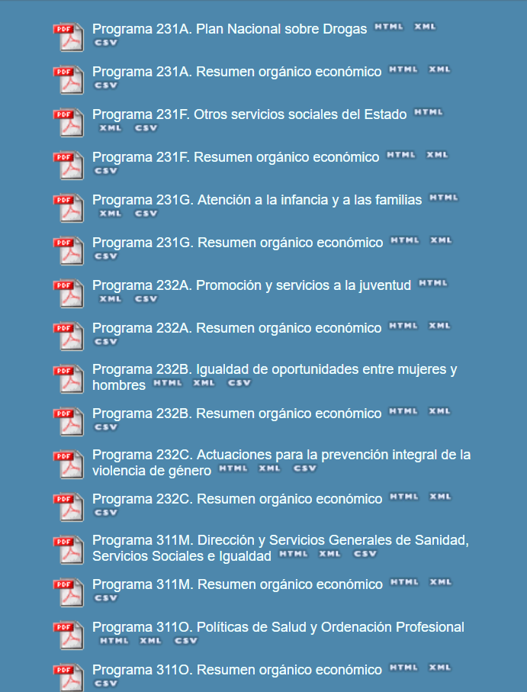
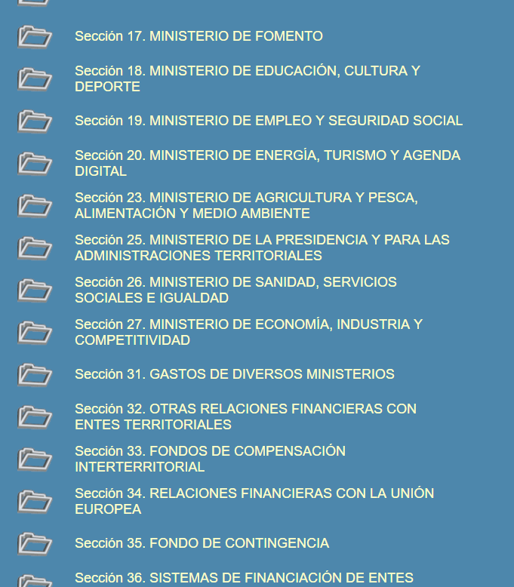
Spanish Model-Domestic Violence: General State Budged
General State Budged

Slide 13
Spanish Model-Domestic Violence:
Thanks!
btardonrecio@tresguineasconsultoria.org

