Slide 1
Referral mechanism and processes for victims of domestic violence, Najoti Kudakon, Tajikistan
Kurbongul Kosimova
Workshop
Mtskheta, May 2018

Slide 2
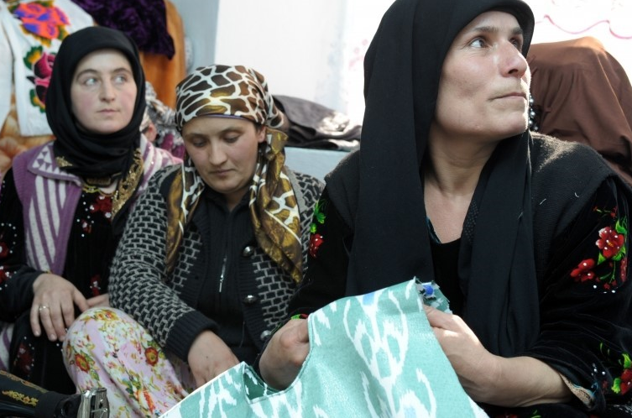
Tajikistan
Tajikistan officially the Republic of Tajikistan
is a mountainous, landlocked country in Central Asia
Population: 8. 03 million
State language: Tajik
Religion: Islam
Currency: Tajik Somoni
Bordering: with Afghanistan from the south,
Uzbekistan to the west, Kyrgyzstan to the north,
and China to the east. Tajikistan became an
independent country in 1991.
A civil war was fought almost immediately after
independence, lasting from 1992 to 1997
Tajikistan is a presidential republic consisting of four provinces (Sughd, Khatlon, Badakhshan and GBAO)
Most of Tajikistan's 8 million people belong to the Tajik ethnic group, who speak Persian Tajik though many people also speak Russian, Uzbek, Kyrgyz, Tatars, Korean
Mountains cover more than 90% of the country

Slide 3
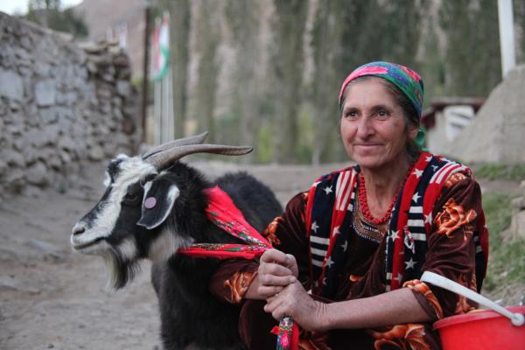
Violence in Tajikistan
Lack of access of rural women and girls to legal aid and psychological services and thus women have limited ability to protect their rights, most of them are financially dependent with limited education and insufficient knowledge.
Lack of effective mechanisms for the implementation of adopted laws and plans, especially recently adopted Law on prevention of domestic violence (2014); low level of gender sensitivity and insufficient knowledge of the judiciary and law enforcement officials on the standards for the legal protection of women.
There are only few shelters and safe houses for
victim of violence functions in Tajikistan.
The impact of gender stereotypes on society’s
attitude towards domestic violence.

Slide 4

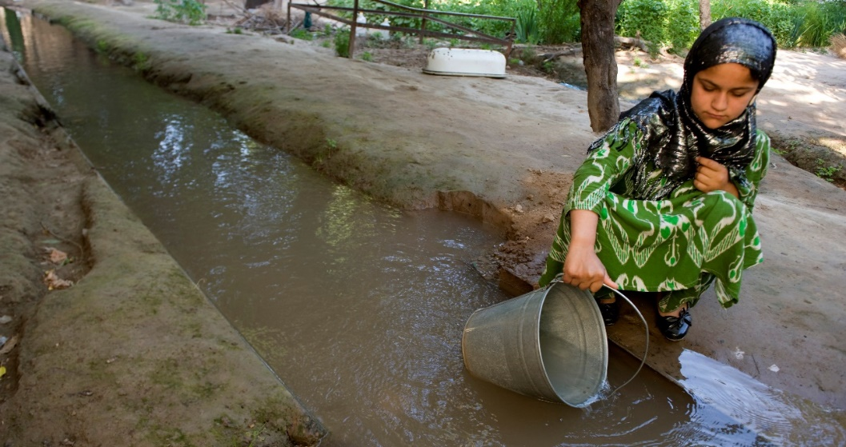
Violence in Tajikistan
Widely spread belief that issue of violence against women is greatly exaggerated and, in comparison with other social problems, is not so important, including domestic violence.
Widespread opinion that domestic violence is a family, private matter. As a proof, people often refer to the specificity of mentality, etc.
«A woman must tolerate violence to keep her family together». This was the answer of 97% of men and 72% of women (Oxfam KAP- survey-2016, Tajikistan).

Slide 5
Key Achievements
NGO Najoti Kudakon is a Coalition of NGOs in Tajikistan which lobbied the Law on Prevention Domestic Violence in Tajikistan and Law was approved by the Government of Tajikistan in 2013.
NGO “Najoti Kudakon” is one of the Women Resources Centres (OSCE funded) that provide legal and psychosocial consultations to victims of domestic violence in Kulob region of Tajikistan.
Twelve Women Support Group (WSGs) created in project targeted communities (members of WSG are former victims of DV) who contribute to assist vulnerable women from the remote distant mountain communities to file their complains and provide necessary assistance.
A shelter for victims of domestic violence established in Kulob region by Najoti Kudakon.
Close collaboration with gender sensitive police station and Najoti Kudakon established as an referral mechanism in Kulob region.
Increased sensitivity of local government agencies to the problem of domestic violence.
WSGs have the potential to lobby for the interests of women and girls of the community and district in the local governmental authorities.
Close cooperation established with the local state structures at community and district levels (e.g. through signed Memorandums of Understanding and developing joint action workplans on ending violence against women).

Slide 6
Key Project Achievements:
Girls and women, including victims of violence in 6 regional centers of Jamoats (Kulyab, Shuroobod, Hamadoni, Vose, Farkhor, Muminobod) have real access to information and services for the prevention of violence. - 6 WSGs successfully operates; There are 90 members of WSGs, including 34 women who suffered from violence at home. They have been trained in the concept of Self Help Group and have the skills to help others.
1058 women received support from WSG and 51 women (among them disabled, victims of violence and migrants wives) were referred to Najoti Kudakon Crisis Centre/shelter and other relevant agencies.

Slide 7
Challenges
There is no centralized statistic on number of victims or cases of domestic violence in Tajikistan.
The cases were seen that husbands, brothers i.e. male relatives don’t let them to participate in trainings and took their wives, daughters from the trainings.
The lawyers in timely manner prepare and submit documents to the court, but the trials last endlessly and victims gave up with no hope for future progress and they are not willing to stand by their rights anymore.
There are cases that women refused to participate in trial and withdrew their applications (opinions of people/neighbors is more important).

Slide 8
Recommendations
Mobilization of resources and continue the work to end violence against women in Tajikistan. Few donors fund the issue of domestic violence in Tajikistan and its difficult.
Capacity building of Women Support Groups as moving from the project based to the programme.
To strengthen the mechanism of implementation of Law on prevention of Domestic Violence.
To conduct campaign to raise public awareness about domestic violence and how to defend potential victims.
To establish new WSGs in new project areas and other region of Tajikistan, as WSGs have enough knowledge and experience.
To disseminate the information the experience and results of the experience of WSGs in national and international conferences (that doing by me now in this conference☺).

Slide 9

Thank you! This presentation was funded by Last Mile4D

Slide 10
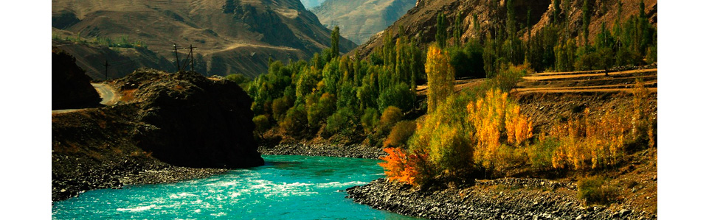
تشکر!

