Slide 1
The Domestic Violence against Women from the Family to the Refugees Camps
( Case study of Syrian women refugee in Kurdistan, Iraqi camps)
Methsketa, Georgia
May 2018
Bayan Azizi
Humanitarian researcher

Slide 2
Outline
Background
  Camp
  Population
  Research methodology
Violence as a pattern in patriarchal society
Lack of agency among women
  Less education
Forced marriage
Honor killings
Laws vs. tradition

Slide 3
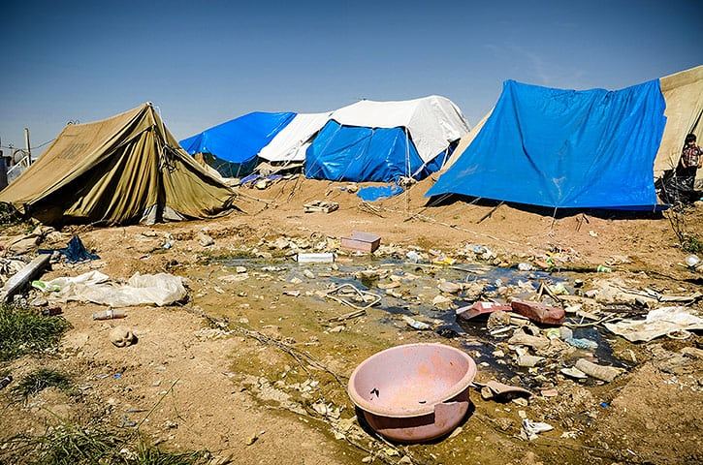
Background
Domiz refugee camp is located in the Kurdish province of Dohuk in northern Iraq. Each week, thousands of Syrian refugees arrive at the camp, which opened in 2012 and was designed to host about 15,000 persons. A year on, however, almost 55,000 refugees live in Domiz, resulting in overcrowding and pressure on food, water and sanitation.

Slide 4
Research Methodology
A yet-to-be published report based on the research conducted by the Norwegian Refugee Council, UN Women, UNHCR, UNICEF, the Warvin Foundation ,Jiyan International Foundation and Salahaddin University in Erbil. Working team consisted of 178 staffs and Bayan Azizi, as the top research adviser in this project.
Methodology
Included 830 Syrian refugee women and 830 Syrian refugee men .
Individuals over 15 years of age
The survey , SPSS method
Year of 2013- 2014. update to 2015
Final report of this research is 386 pages in three languages.

Slide 5
Men & Women Reaction to the Questions
Women’s reaction to questions
Since the interviews are recorded in special sheets, women are afraid that these answer sheets might later be used against them, thus women’s confidence in the interviewers were low.
Women are very modest and cannot speak openly about many problems especially questions of sexual violence. They were ashamed.
Women’s lack of familiarity with the types of violence and their getting used to these cases of violence and lack of attention to these types of violence.
Men’s reaction to questions
The patriarchal culture dominating the lives of refugees, for example, it could be stated that men did not allow women to be interviewed and insisted that they must be present to know what answers women will give.

Slide 6
The relationship between domestic violence & immigration
Women and children are not the cause of wars but they are victims of violence in conflicts.
During wartime, this violence is multiplied. the domestic violence does not disappear and transfer to the new refugee location . domestic violence stay by the men members family and the powerful customs.
This becomes important when the family is separated from their original location and moved to another location. In addition to all the previous problems, now immigration problems will be added to family problems.

Slide 7
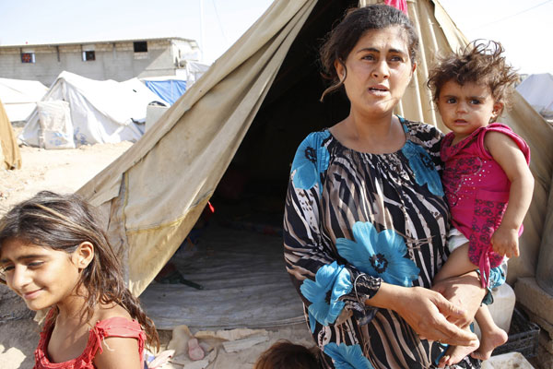
Violence as a pattern in patriarchal society
1- The violence that stems from the family and hurts the body, spirit and personality of women.
2 - The violence that originates from the deep social structure and the patriarchal environment and is injected into the families and destroys many human relationships within the families.
3 - The violence that the host community imposes on refugees which harms both women and their families. This violence is economic, political, social, verbal, physical, sexual and psychological

Slide 8
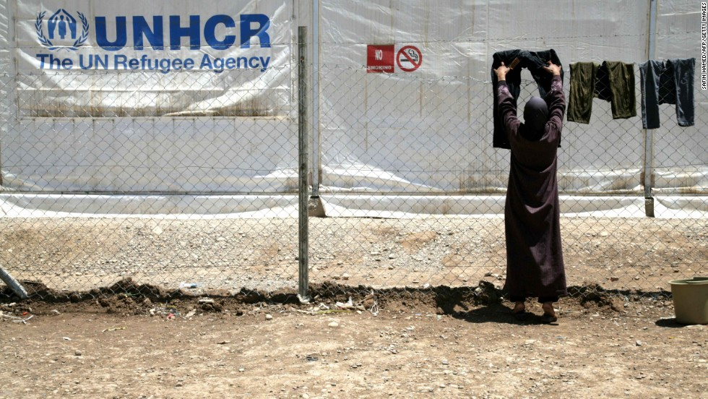
Violence as a pattern in patriarchal society
4 – The violence imposed by women on theirs and other women's bodies and spirits. Sexual violence by women against other women in the form of forcing them into prostitution, circumcising girls, accusing them of having sex, strict control and preventing girls or women from having sex

Slide 9
Lack of agency among women
1) Sexual aggression, rape, sexual violence and sexual abuse by husband, male family members, other men, colleagues, neighbors, police, government employees and NGO staff
2) Psychological violence
3) Illiteracy or low level of education
4) Poverty, unemployment
5) Lack of services for disability women or special situation
6) Early marriage
7)Prohibiting and controlling frequentation of women and girls by men
8) Forced marriage
9) FGM (this has been studied in field researches)
10) Lack of security whether at home or outside
11) Lack of familiarity with health services
12) Disinheritance, laws of inheritance against women inheriting real property
13) Not knowing about their own rights

Slide 10
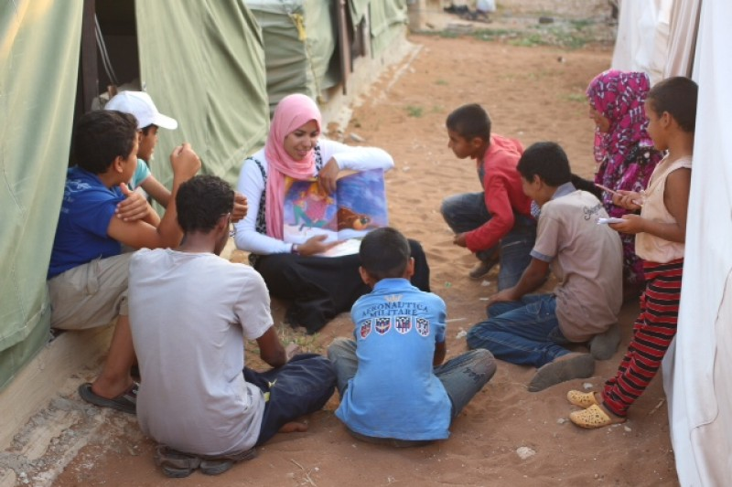
  Less education
Many families prefer to keep young girls and women in the camp homes and do not allow them to leave the camp or even going to school or work outside this environment. Several cases of sexual harassment of women at camps have been reported. In several cases, women referring to the center had married below the legal age.

Slide 11
Forced Marriage
Families force their daughters to get married below the legal age in order to protect them; sometimes with relatives in European countries, sometimes with a wealthy man and sometimes with close relatives. Girls often are not ready for such marriages.
Because of the unsafe and dangerous host society, the family of refugee keep them in the home cycles and its add to the domestic violence. Sexual aggression, rape, sexual violence and sexual abuse by husband, male family members, honor killing and threat the women to honor killing are some of the phonemes in this situation

Slide 12
Violence against young girls, marriage low age
According to Syria and Iraq’s laws and Kurdistan's laws too, marriage under 18 years old is considered as a crime but according to Islamic rules marriage at any age is not forbidden and the father can make his daughter marry to any man without regarding
More than 60% of the families said they made their daughters marry during the exile. More than 54% said marriage was the best way to protect their daughters.
More than 47% of the girls who got married under the legal age have got pregnant. More than 85% of the girls had no information of pregnancy contraception.

Slide 13
Do you and your daughters feel safe at home?
Safety means being safe and having no fears. it means a situation in which one is protected against harm, risks or being hurt. Lack of safety poses experiencing and living in fear in domestic or social environments.
Fear of men’s violence, fear of being hit by their husbands, fathers or brothers, fear of being raped or sexual violence or being threatened to face such things, fear of being threatened to death and financial limitations.
never: 61.6%, sometimes: 18.2%, rarely: 12.7%, always: 7.3%

Slide 14
The Honor Killing
Simply, honor killing means women’s murdering by their male relative because of reasons that is only acceptable on those traditions. It means protecting sexual virtuosity by woman’s close relatives, because of having relationship with a man who is out of family permission or being raped by another man.
Exiled women remember so many murder cases of women getting killed by their male relative happened in their hometown or witnessed it during the exile or have been threatened to it.

Slide 15
Laws vs. tradition
One of the issues that affects women’s gender crucially in some places around the world especially in Middle East is the “taboo” of girls’ being or not being virgin.
the woman has no will over her body and the value of a human being depends on a thin tissue that scientifically speaking doesn’t have any particular use and the fate and the future of a girl depends on having or not having that tissue.
Losing virginity y=death
L.v= forced marriage
L.v=hard punishment
L.v= family and society getting out

Slide 16
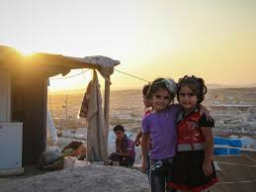
Virginity taboo and a matter of life or death
To find out that a girl is not virgin particularly by her own family is a threatening factor.
the girl will be death threatened or they will be imprisoned and they will be behaved as a filthy person.
Girls who have lost their virginity willingly or not, have suffered from negative psychological effects including suffering from psychological disorders and in many cases have tried to commit suicide and have had unpleasant feelings during their everyday life.

Slide 17
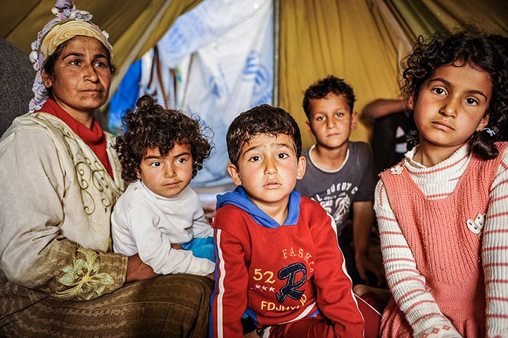
Violence goes on…
In fact, the problems of women in the camp are much more than past. Unfortunately, there is no improvement in the state of observation. Violence continues from the homes to the camps.

Slide 18

Thank you!
This presentation was funded by Last Mile4D

