Slide 1
“Capacity Development, Governance, and Leadership”
Mtskheta, Georgia
May 2018
Mahnaz M. Harrison,
President & CEO Last Mile4D

Slide 2
Outline
Capacity development/building
Governance
Leadership and board
Organization development and iteration

Slide 3

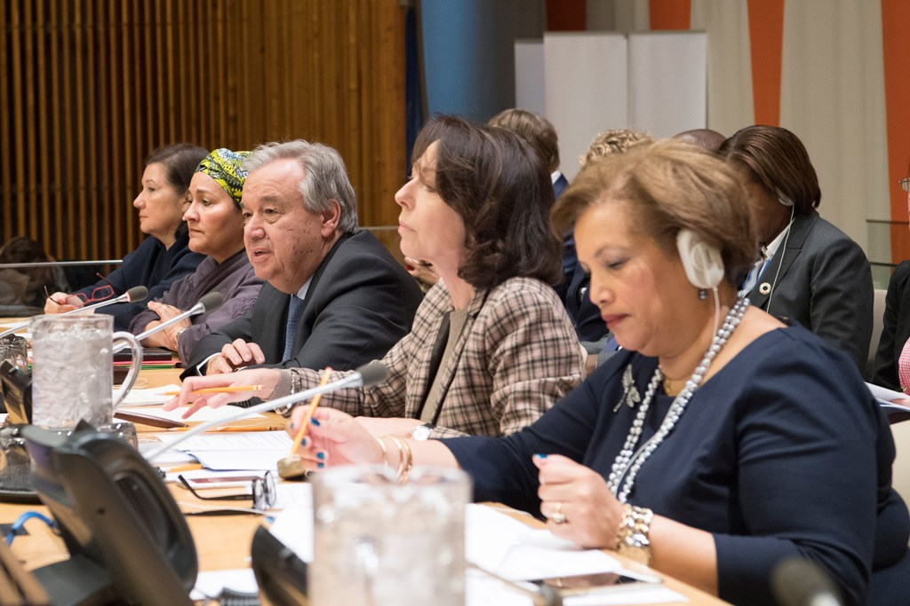
Capacity Development– United Nation Development Program (UNDP)
Capacity development is a process through which individuals, organizations and societies obtain, strengthen and maintain the capabilities to set and achieve their own development objectives over time.
Simply put, if capacity is the means to plan and achieve, then capacity development describes the ways to those means.
The ability to perform functions, solve problems, and achieve objectives.

Slide 4
Capacity Development
At three levels:
Enabling environment
A social system that includes people, societal norms, policies, laws and rules that governs civic engagement
Individual
Workforce – skills, knowledge and experience
Leadership – comprehensive understanding
Institutional
Internal structure
Policies, procedures and iterative planning

Slide 5
Capacity Development/building
Aspiration
Strategies
Organizational skills
Culture
Human resources
Systems and infrastructure
Organizational structure
From Venture Philanthropy Partners’ Inc.
www.lastmile4d.org

Slide 6
Capacity Development/building
Higher-level elements:
Aspirations – mission, vision …
Strategy – actions and programs
Organizational skills – planning, resource management …
Foundational elements –
Systems and infrastructure, administrative, accounting …
Human resources
Organizational structure – governance, management …
Cultural
www.lastmile4d.org

Slide 7

Governance
Governance is the process of providing strategic leadership to an NGO → setting direction, making policy and strategy decisions, overseeing and monitoring organizational performance, and ensuring overall accountability.
Nonprofit governance is a political and organizational process involving multiple functions and engaging multiple stakeholders.

Slide 8
Governance
Authority
Decision making
Accountability
Governance determines who has power, who makes decisions, how other players make their voice heard and how account is rendered.
Institute on Governance

Slide 9
Governance
Informed organizational choices:
Why we are here?
What we want to accomplish?
How to best achieve the desired results?
What resources are needed?
How to secure the resources?
How do we know if we are making a difference?
Governance is essentially a decision process grounded in the assumption that organizations can cause desired results to occur by choosing appropriate courses of action.

Slide 10

Leadership
Leadership is the ability to influence, inspire and motivate others to achieve or even go beyond their goals. It is also the ability to anticipate and respond to change. Leadership is not necessarily synonymous with a position of authority; it can also be informal and be held at many levels.
UNDP

Slide 11
Leadership – Board vs. Management
A board is an organized group of people with the collective authority to control and foster an institution that is usually administered by a qualified executive and staff
Board
Management
Management refers to the routine decisions and administrative work related to the daily operations of the organization.
Management decisions should support or implement goals and values defined by governing bodies (such as the Board of Directors) and documents (such as the bylaws)
Governance is the act, process or power of governing.
https://www.boardeffect.com/blog/board-of-directors-vs-management/

Slide 12
Leadership – Board

Slide 13
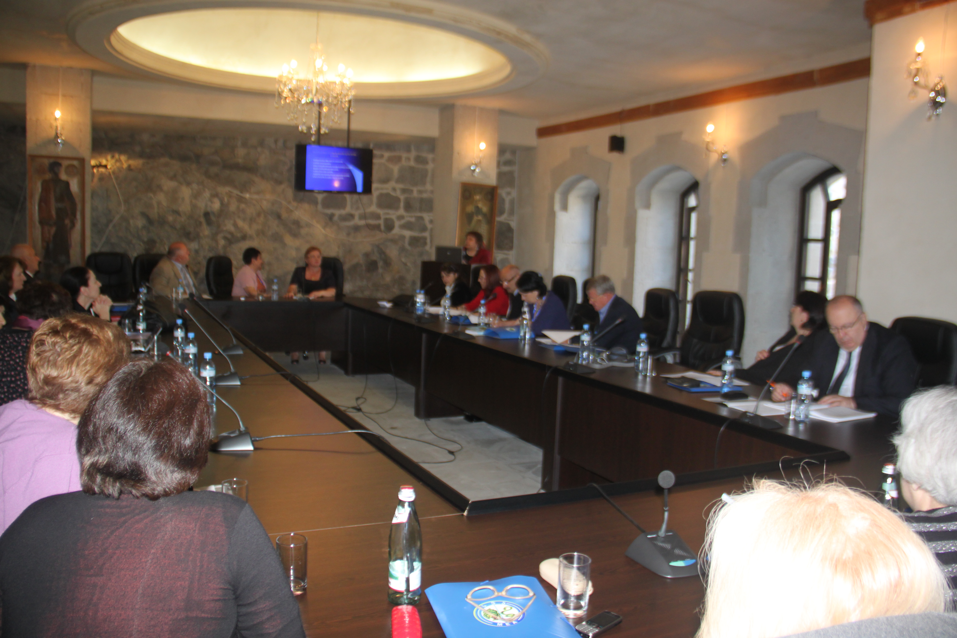
Leadership – Management
Making operational decisions
Making operational policies
Keeping the board educated and informed
Bringing well-documented recommendations and information to the board

Slide 14
Leadership –linkages
Area of
negotiation:
flexible, and
dynamic
Staff Role
Board
Role
Management
Governance
www.Hospiceuk.org

Slide 15
Organization development and iteration
Start-up | 1st phase of growth | Transition | 2nd phase of growth | Integration
Leadership Dynamic Vision Energized Agile | Beyond start-up New Leadership Succession planning Resource strap | Systems Standardisation Specialisation | Stagnation Leadership Out of synch less clarity | Engaged leadership Engaged staff Team work Diversity of skills Energy shift

Slide 16
THANK YOU!
This presentation was funded by Last Mile4D

